Slide 1



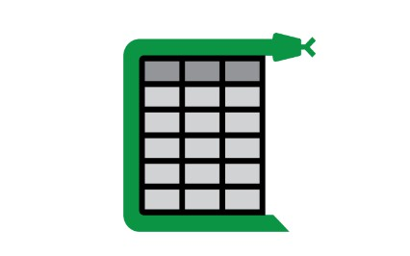

Workflow:
Passing page one by one to camelot and layout parser
Layout Parser
(Detect the table from pdf).
Passing table Coordinates
Match if keywords are present, If yes store tha table in png format.
Camelot (Extract table from pdf) and store it in form of pandas dataframe
Check if the table has stats if yes then go to next step

Slide 2
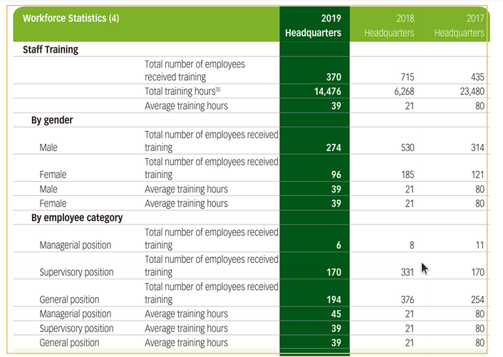
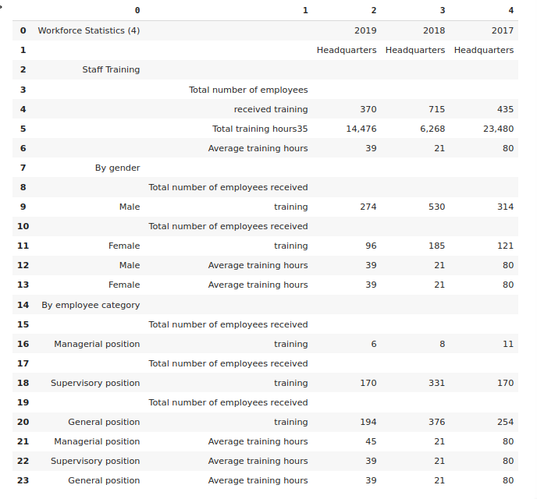
Tech Stack used:
1) Layout Parser
A unified toolkit for Deep Learning Based Document Image Analysis which can detect tables from the pdf.
2) Camelot
A python library that extract tables from PDFs

Slide 3
PolyFuzz:
PolyFuzz performs fuzzy string matching, string grouping, and contains extensive evaluation functions.
Pymupdf (Not integrated to the solution)
Extract text from arbitrary supported documents (not only PDF) to a textfile. It can also maintain the layout.
It can also be used to extract the table of contents/outlines from the PDF.

Slide 4
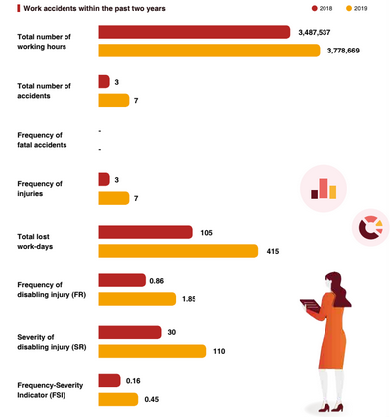
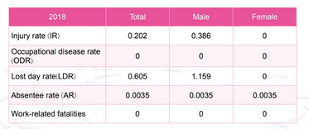

SCENARIOS:
Infographics/charts:
Table:
Text:

Slide 5
Future Scope:
Extract the figures from PDF using PDFFigures
PDFFigures 2.0: is a Scala based project built to extract figures, captions, tables and section titles from scholarly documents.
Features:
The page the figure occurs in (0 based).
The bounding box of the figure within that page, given as pixel coordinates where (0,0) is the top left of the PDF's cropbox and the page is assumed to be rendered at 72 DPI.
Any text that occurs inside the figure.
The caption of the figure.
The bounding box of the caption.
The 'name' of the figure as deduced from the caption. Usually, this is a number (ex. the name of a figure captioned "Figure 1" would be "1"), but it might take on some other form depending on the PDF parsed.
Whether the figure was labelled as a Table or a Figure, again based on the caption.

Slide 6
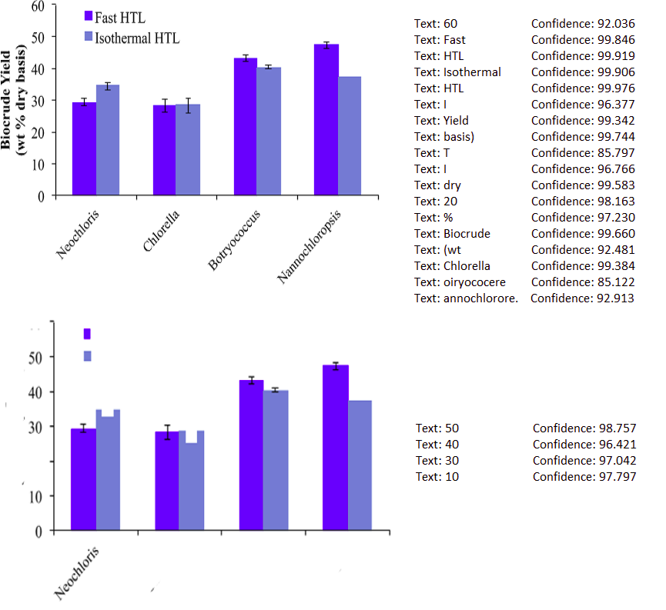
ChartReader:
to extract data from bar plots and other figures in scientific research papers using modules such as OpenCV, AWS-Rekognition for text detection in images.

Slide 7
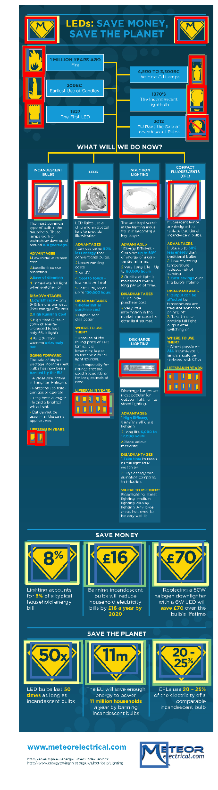
Visually29K: a large-scale curated infographics dataset
To capturing info graphics and then text can be extracted inside or outside it using defined coverage area.

